Slide 1
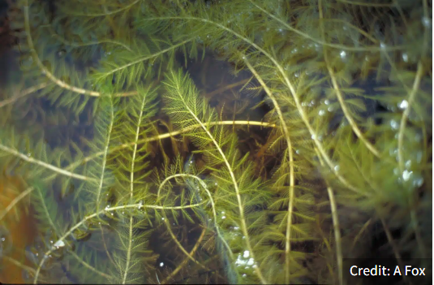
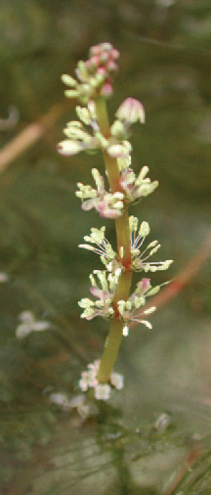
What is the Eurasian Watermilfoil?
Tiny reddish flowers emerge above the water surface in late July and early August
Plant native to Europe, Asia and North Africa.
This invasive plant was introduced in Quebec in the 1950s and first spread along the St. Lawrence River. It is now present in several lakes in the Eastern Townships, Montérégie, Laurentians and Outaouais, including Lac des Plages, Lac des Îles, Lac Chapleau, Lac Hotte, Lac Vert, Lac Schryer and Lac St-Émile.

Slide 2
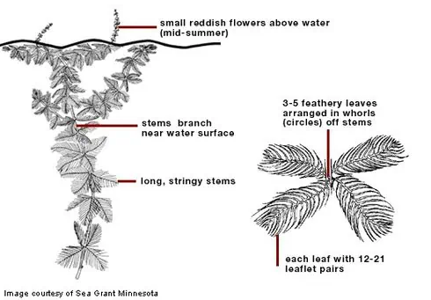
Could You Identify It?
A submerged perennial aquatic plant that is visible at the water's surface.
Its leaves are very thin, feathery and green-black. They grow in numerous small leaflets in whorls of four off the stem.
Leaves have 12 or more thread-like segments, that appear to have been clipped at the end.
Distance of one cm between the whorls
Tiny, reddish flowers grow on spikes five to 20 centimeters long that rise above the water).
It differs from native watermilfoils that usually have less than 12-14 leaflets on one side of the leaf that are much closer together.
Source: https://www.creat0.ca/milieux-humides-1

Slide 3
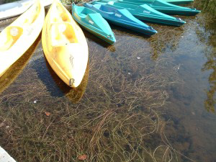
Why is This Plant a Problem?
Eurasian watermilfoil spreads much more rapidly than other plants. It invades the water, forming dense mats one to ten meters deep, which seriously hamper water-based activities (swimming, fishing, boating, canoeing, pedal-boating, kayaking).
Source: http://www.obvcapitale.org/plans-directeurs-de-leau-2/attachment/myriophylle-a-epi-au-lac-delage-3

Slide 4
How Does it Spread?
The plant spreads from one body of water to another by boats and their trailers, watercraft of all types, flotation devices, etc.
It is easily spread by recreational boating and aquatic activities.
The plant's stolon, roots and low shoots persist throughout the winter.
Growth begins when the water temperature reaches 15°C.
It grows quickly and early, which gives it an advantage over other native plants.
It dies off at the end of summer.
Source : http://www.environnement.gouv.qc.ca/biodiversite/especes-exotiques-envahissantes/myriophylle-epi/index.htm

Slide 5
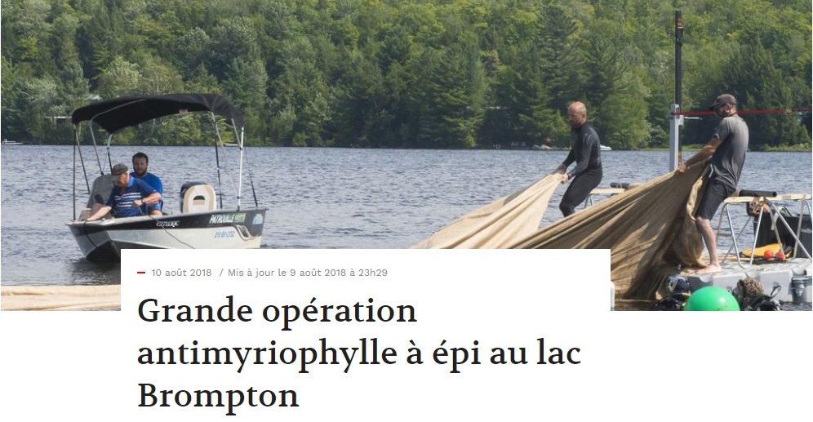
How to Eradicate It
With considerable difficulty!
The recommended method is to prevent it growing vertically by covering it with a thick jute mat.
A complicated and costly operation!
Cover the weed bed, anchor it with weights and monitor it!
The municipality of Brampton spent $65,000 in 2018.
In Ste-Marguerite-du-Lac-Masson, $6,000 was spent in two days to extract the weed bed.
At Lac des Plages, they have spent tens of thousands of dollars and mobilized numerous volunteers every weekend from May to September, and the problem is far from under control!
Source : https://www.latribune.ca/actualites/estrie-et-regions/grande-operation-antimyriophylle-a-epi-au-lacbrompton-9a49a22442728b6959b6c1750246b321

Slide 6
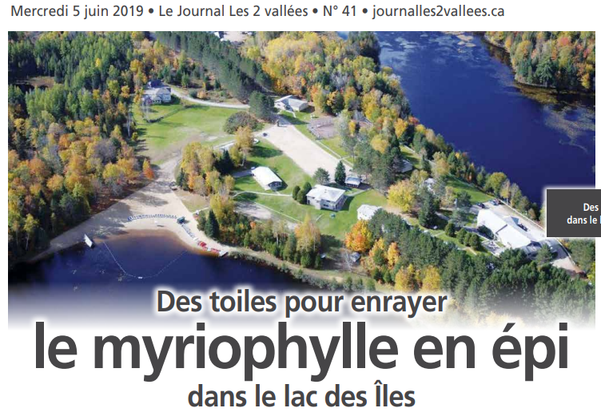
What if We Find Some in Lac Gagnon…
Cordon off the area around the weed bed and prevent access.
Obtain provincial government authorization and funding to launch a removal operation.
This is a lengthy process, during which time, the plant would continue to grow.

Slide 7
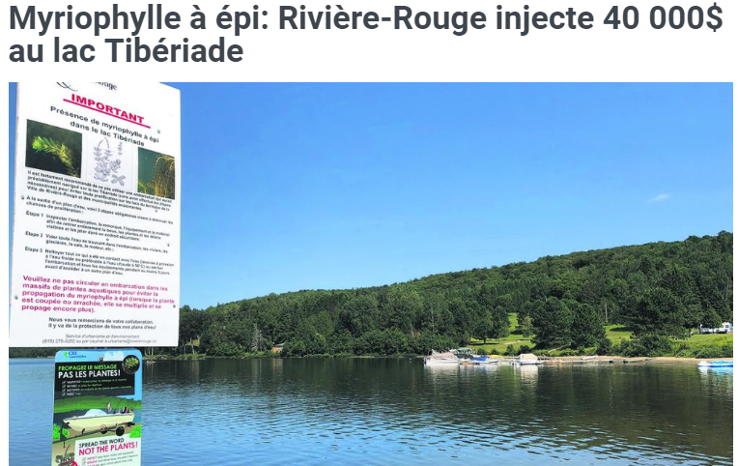
What Would Be the Impacts?
It would be impossible to use the lake near the weed bed because of the risk of accelerating the plant’s spread.
Property values would decline
significantly.
This would reduce municipality's tax
base and result in a decrease in
services offered to all residents of
Duhamel.
https://lecourant.ca/articles/3412-myriophylle-a-epi-riviere-rougeinjecte-
40-000-au-lac-tiberiade.html

Slide 8
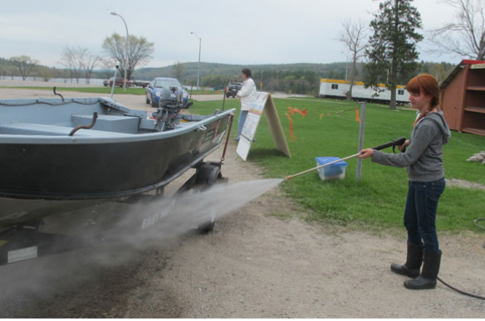
The Solution? Prevention and Education!
You can do your part:
Wash boats, nautical equipment and trailers arriving from another body of water.
Where?
Behind the municipal building in Duhamel
Watercraft washing checklist
Make your neighbours aware of the dangers of spreading the plant.
Support the Sentinelles project and inspect the shoreline in front of your property.

Slide 9
The Lac Gagnon Sentinelles
This project was launched in 2020 in partnership with the municipality of Duhamel and the OBV. Its aim is to detect the presence of Eurasian watermilfoil at an early stage and alert the authorities quickly.
Around thirty volunteers examine the lake bottom along the shore in search of Eurasian watermilfoil. The idea is to take a few minutes, once during the summer, to examine the aquatic plants while out kayaking, canoeing, paddleboarding, snorkeling, etc. Then simply email the person in charge of the project at the APLG to let them know whether or not any Eurasian watermilfoil has been detected.
A short training course is given in July each year. The necessary inspection equipment is also provided (aquascope, checklist, identification sheet, flag with the municipality's logo).
We need more help. Some sections are very long and there are still sections to be assigned. Everyone can do their part!

Slide 10
Other Useful Preventive Measures
Find out more about invasive aquatic plants and, over time, take note of any changes you observe near your cottage. The following site contains useful information: (French only) http://www.environnement.gouv.qc.ca/eau/paee/index.htm
Make your shoreline more resistant to Eurasian watermilfoil. Replant the shoreline on your property, because in addition to limiting erosion, you restore the filtering role played by shoreline vegetation and reduce the harmful effects of fertilizers, pesticides and sediments contained in runoff water. What's more, you create a shield from the sun to limit warming of the water, and provide habitat, food and shelter for wildlife.
Keep up to date with the municipality's projects and policy regarding Eurasian watermilfoil, and don't hesitate to ask for information from elected municipal officials and members of the APLG executive.

Slide 11
In Conclusion
To our knowledge, there is no Eurasian watermilfoil in Lac Gagnon. However, it is found in many lakes around us. Given its proximity to the Duhamel lakes, we need to step up our prevention and education efforts to stop this plant from taking root here. But these efforts are nothing compared to the cost and energy that would be required if Lac Gagnon were to become infested.
If you have any comments or suggestions, please let us know by writing to us at info@aplg.ca.
The APLG will continue to work with the municipality, the OBV and other lake associations to raise awareness and ensure that rigorous boat washing practices are applied.
Prevention, awareness, education: it’s everyone’s responsibility!

